Slide 1
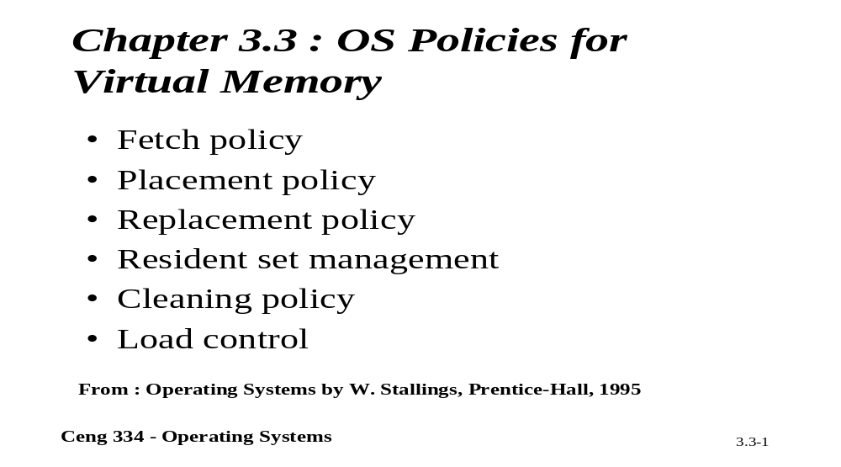
Chapter 3.3: Operating System Policies for VM

Slide 2
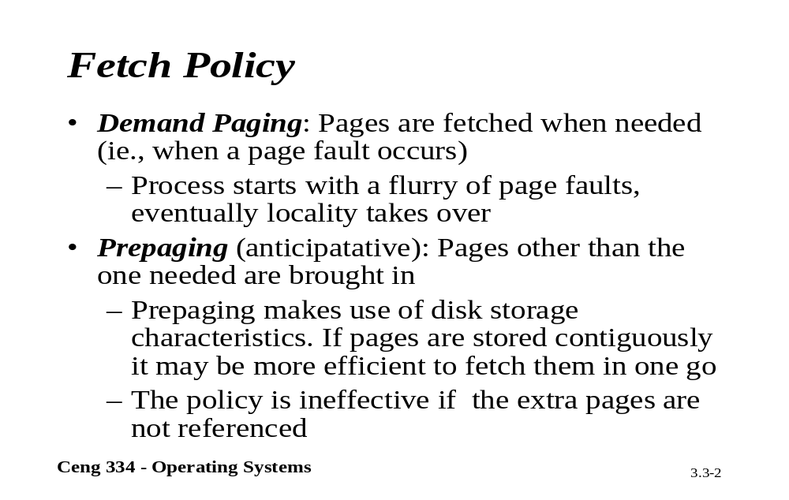
Fetch Policy

Slide 3
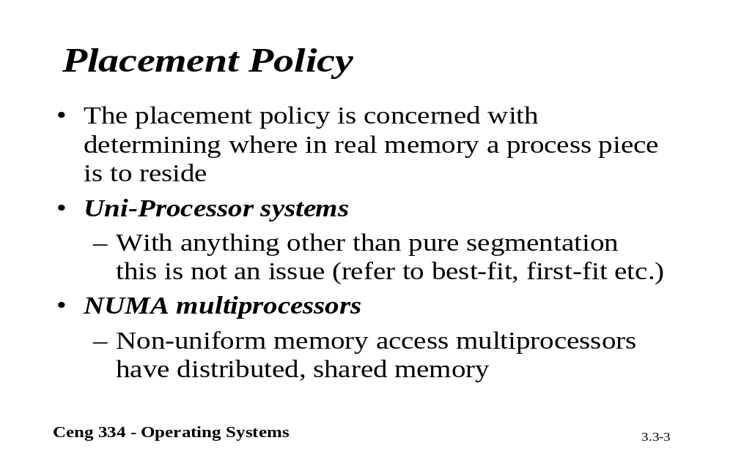
Placement Policy

Slide 4
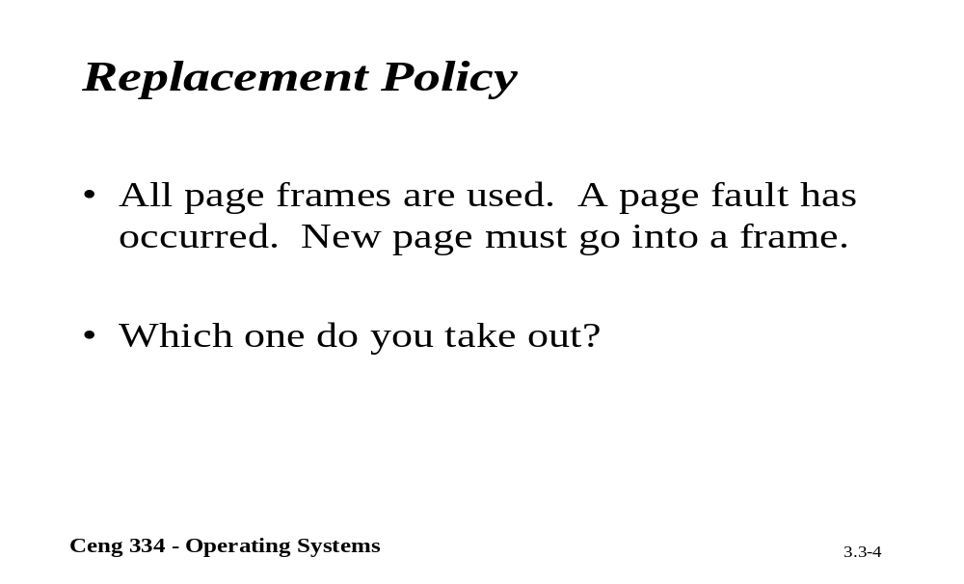
Replacements Policy

Slide 5
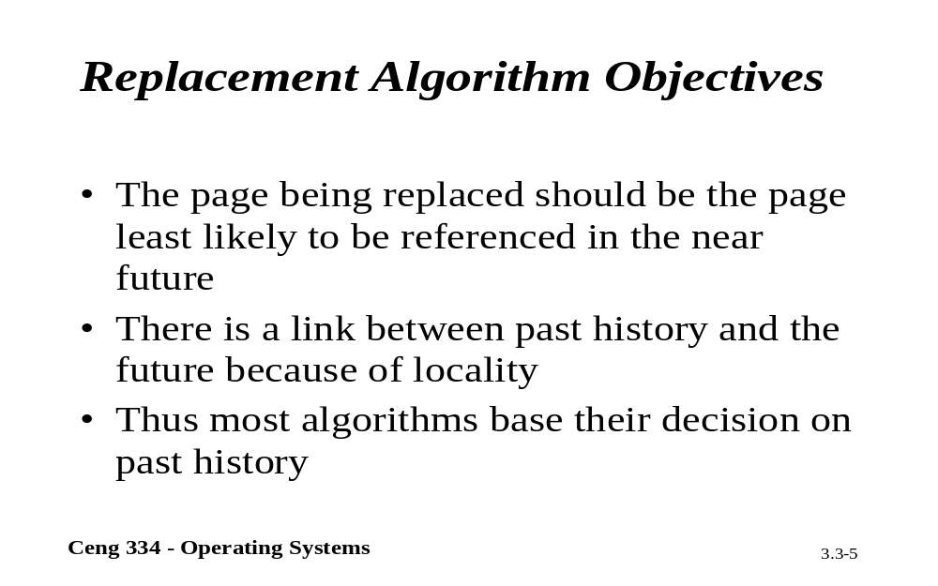
Replacements Algorithm Objectives

Slide 6
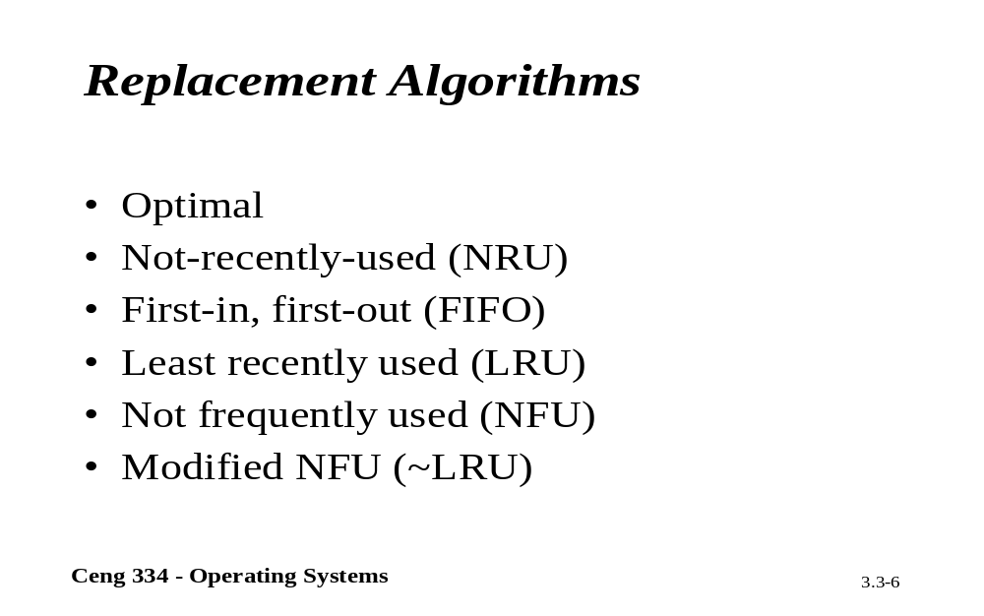
Placement Algorithms

Slide 7
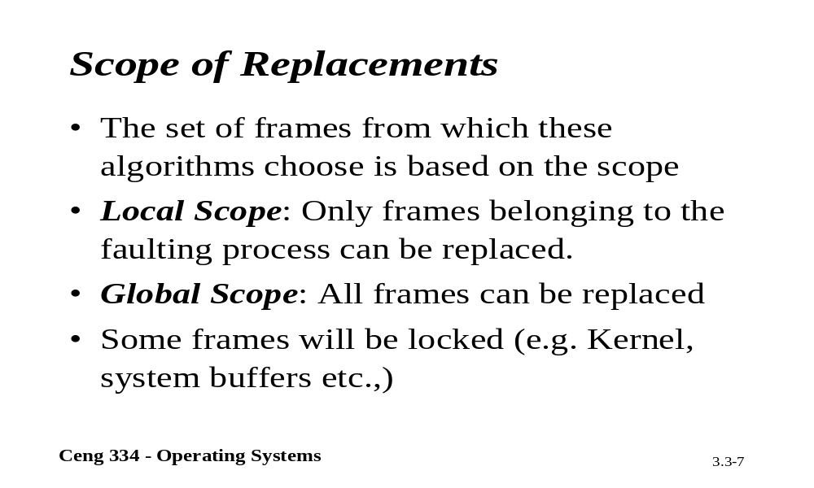
Scope of Replacements

Slide 8
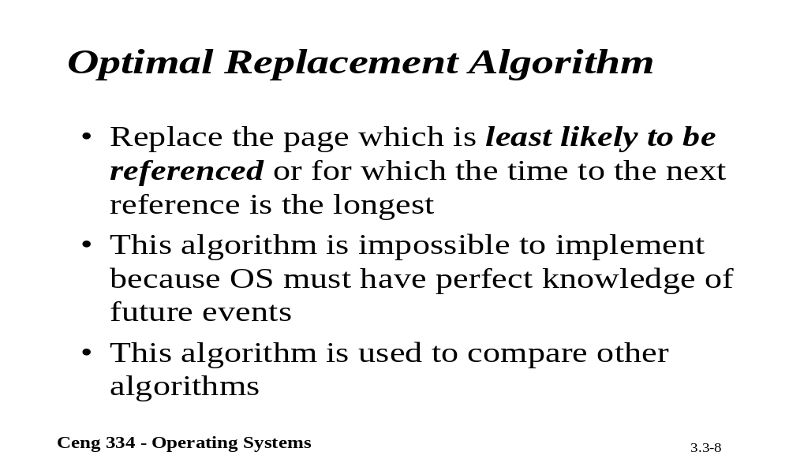
Optimal Replacement

Slide 9
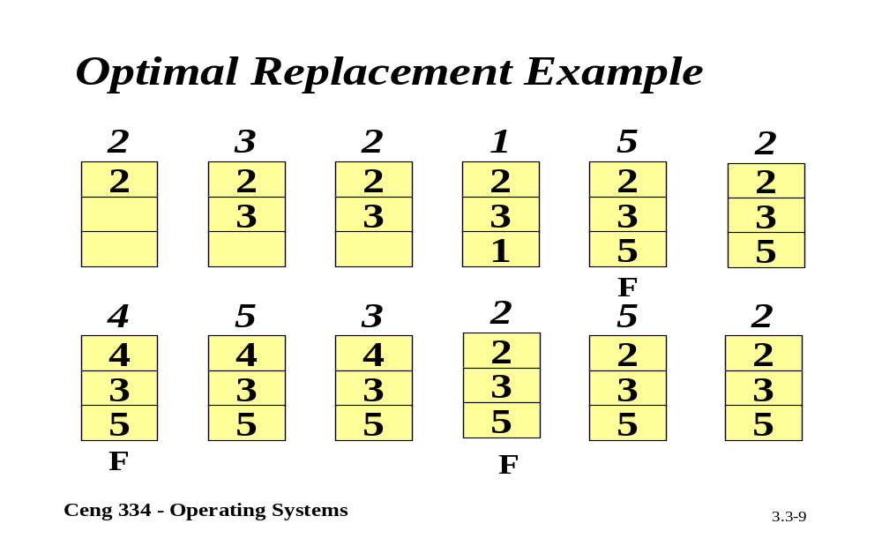
Optimal Replacement

Slide 10
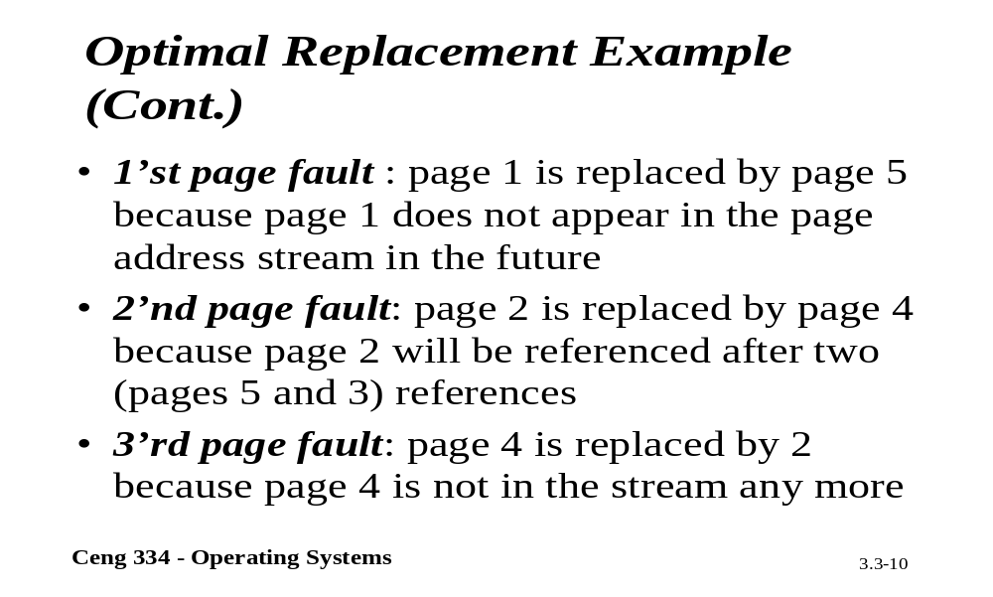
Optimal Replacement Example

Slide 11
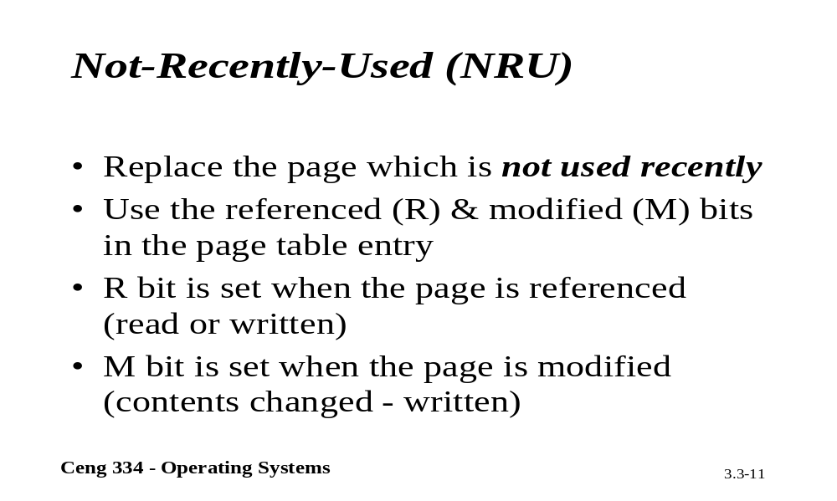
NRU

Slide 12
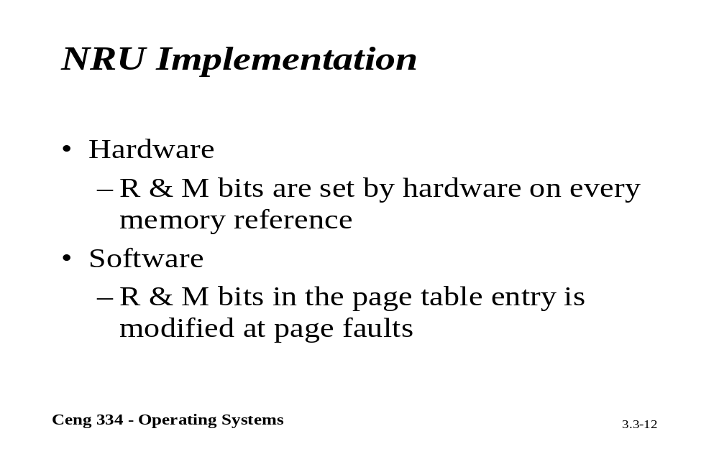
NRU Implementation

Slide 13
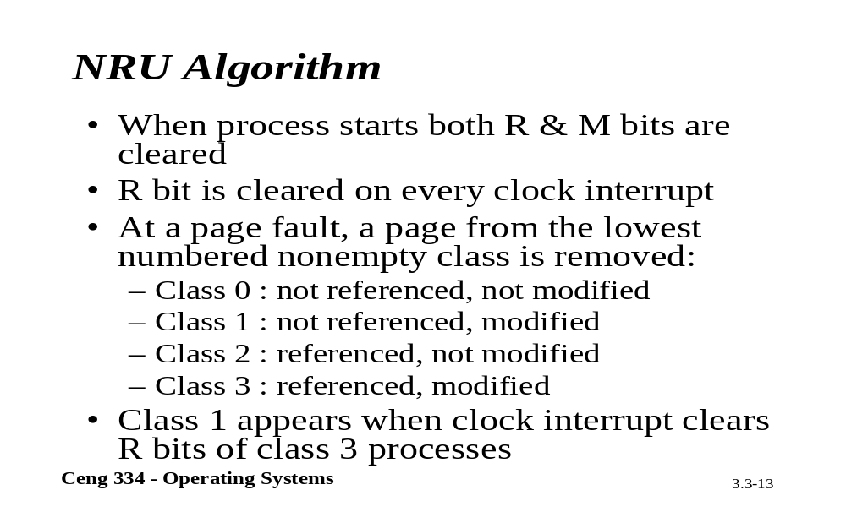
NRU Algorithm

Slide 14
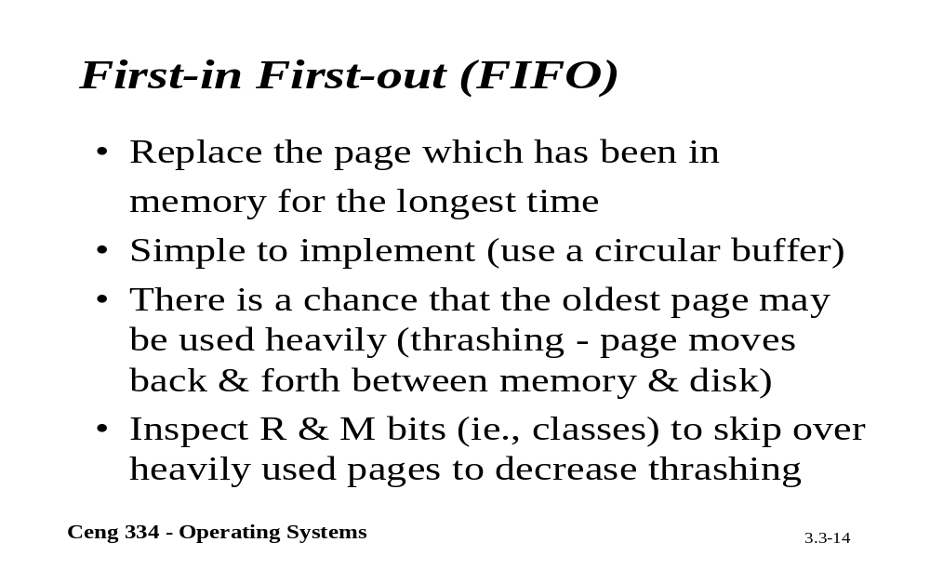
FIFO

Slide 15
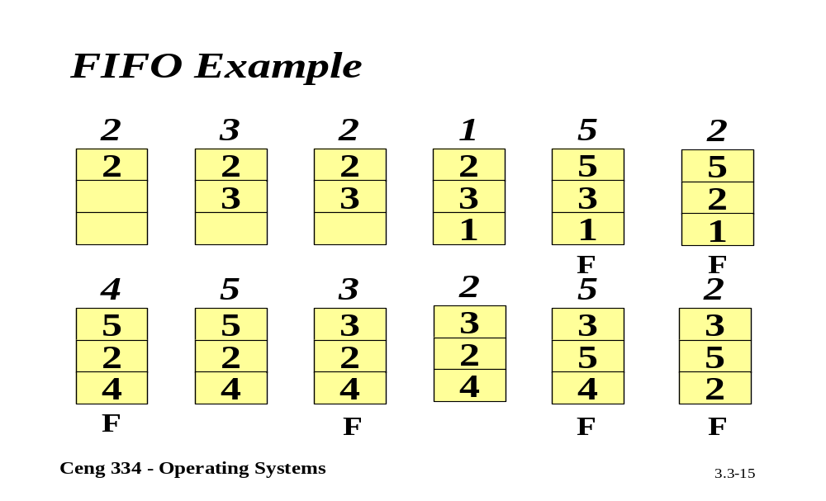
FIFO Example

Slide 16
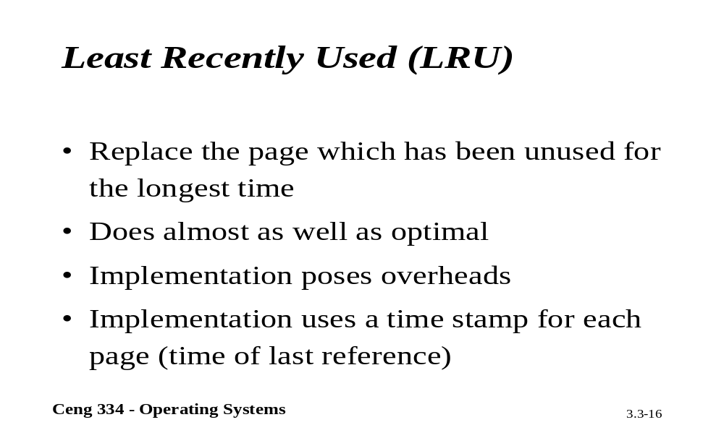
LRU

Slide 17
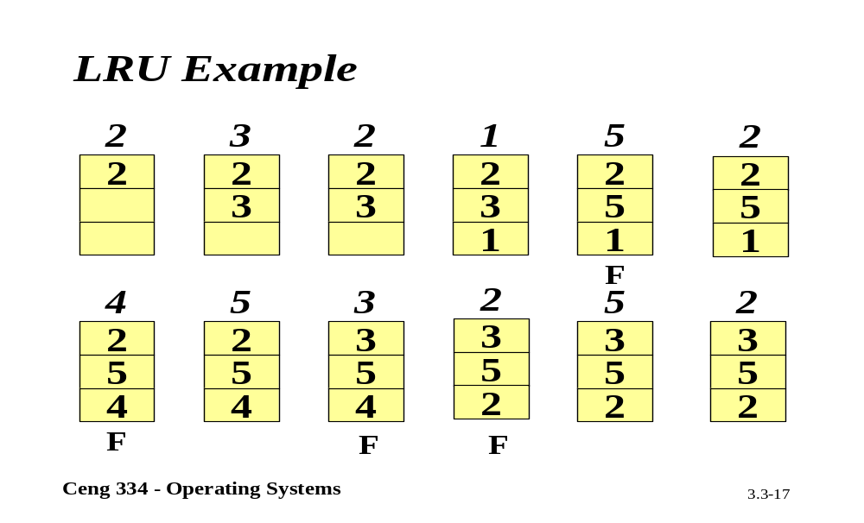
LRU Example

Slide 18
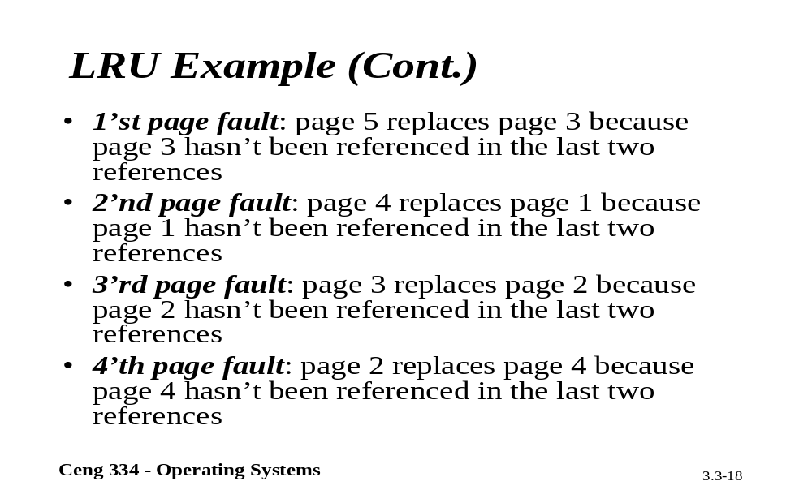
LRU Example

Slide 19
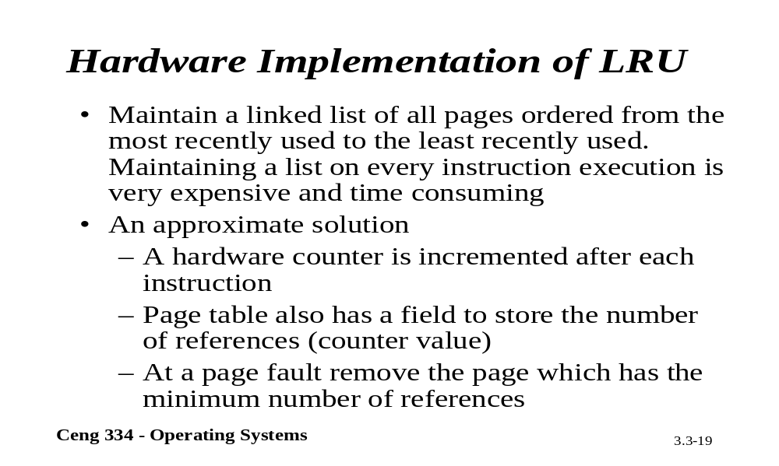
Hardware LRU

Slide 20
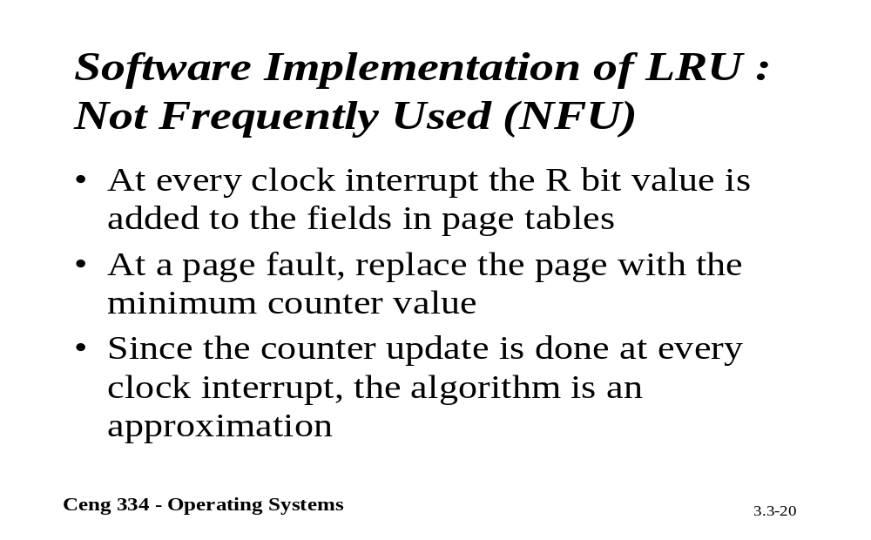
Software LRU: NFU

Slide 21
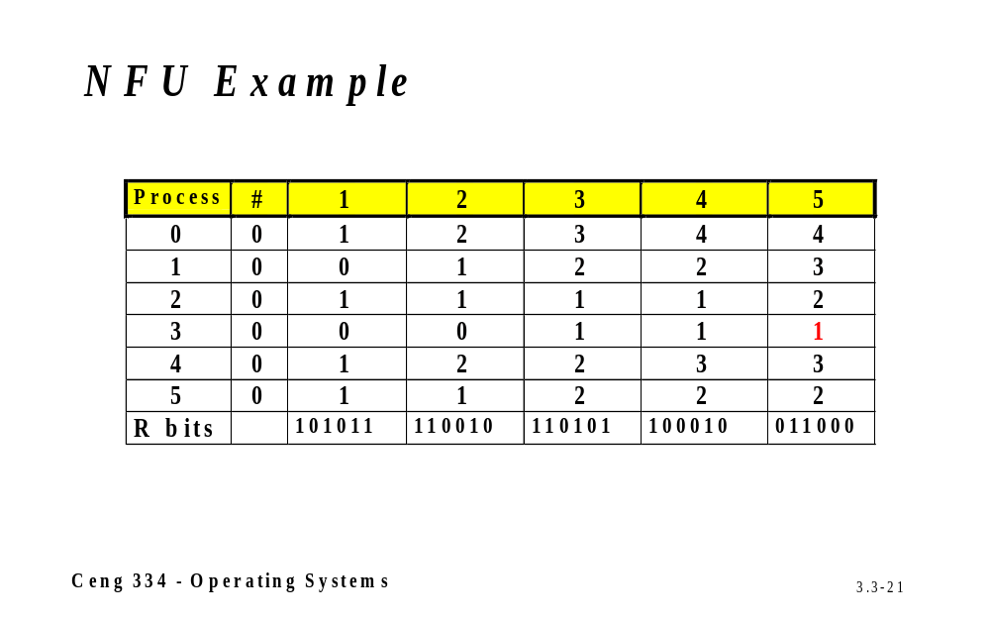
NFU Example

Slide 22
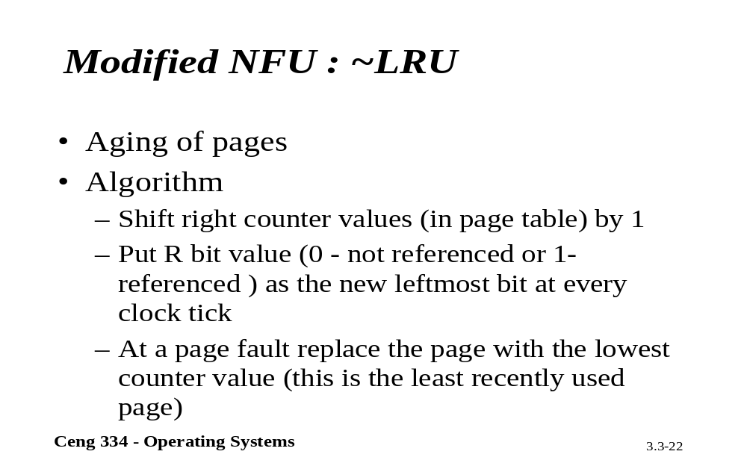
Modified NFU : ~LRU

Slide 23
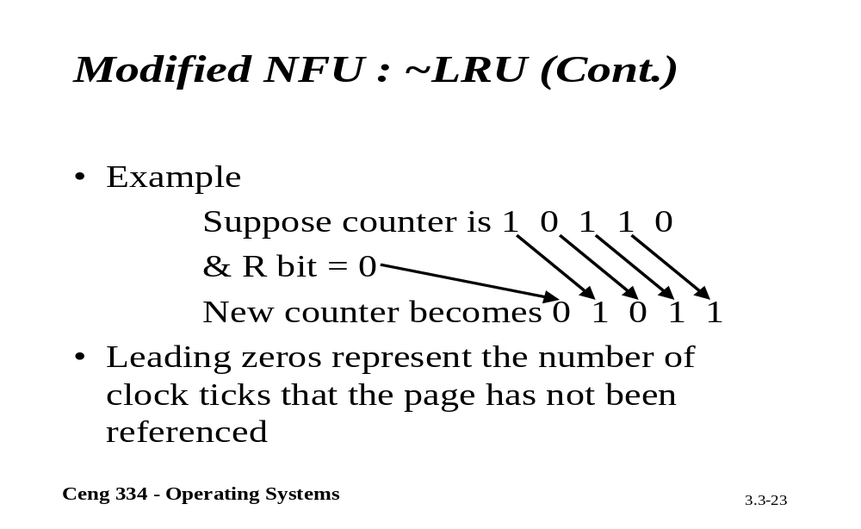
Modified NFU : ~LRU

Slide 24
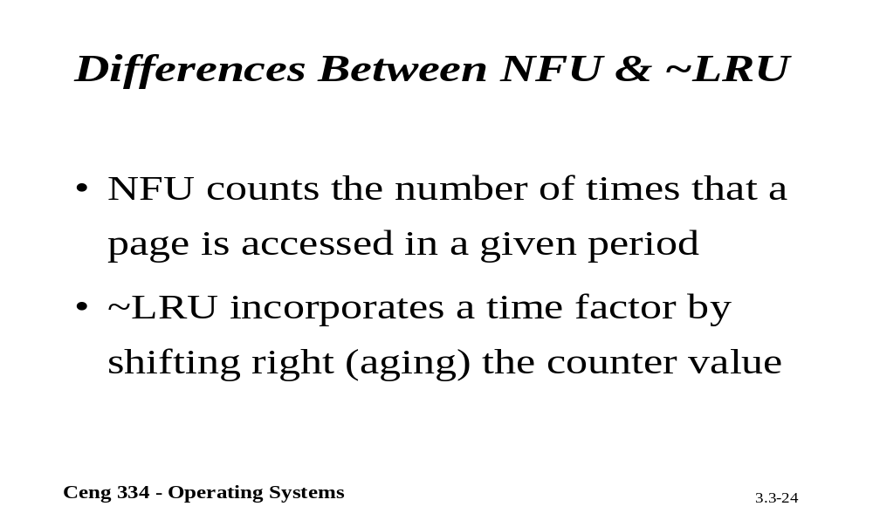
Compare NFU and ~LRU

Slide 25
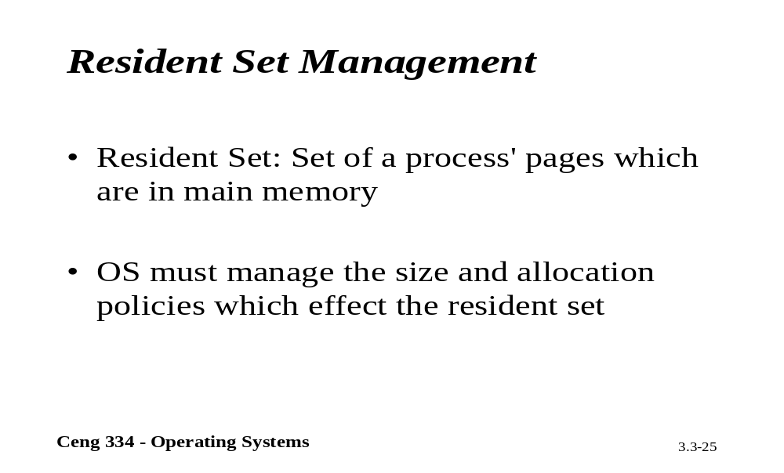
Resident Set Mangement

Slide 26
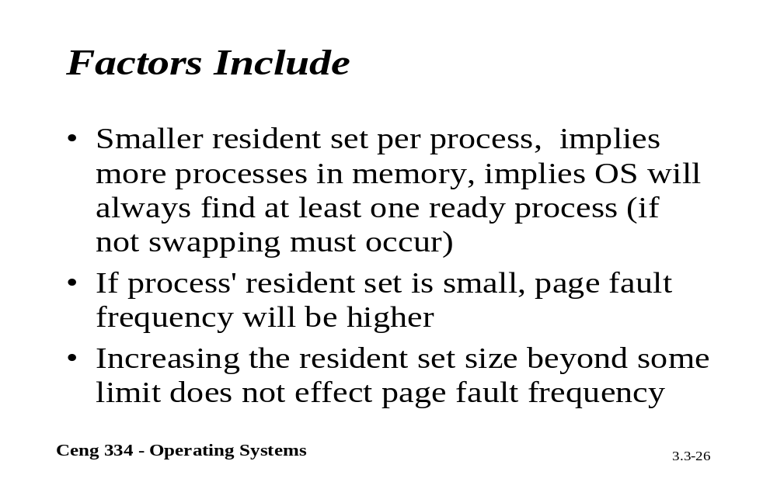
Factor Include

Slide 27
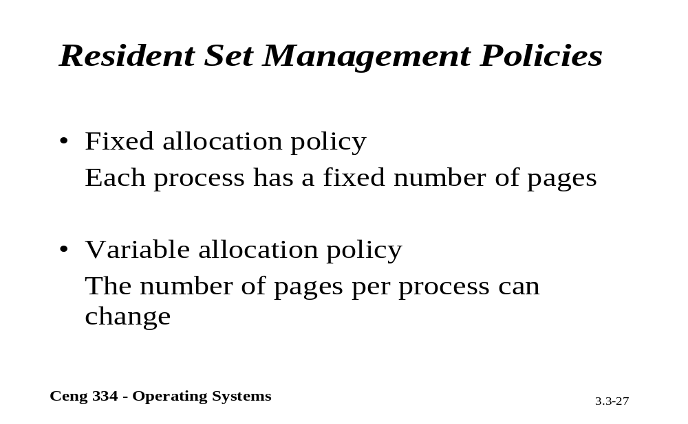
Resident set Mnag. Polcy.

Slide 28
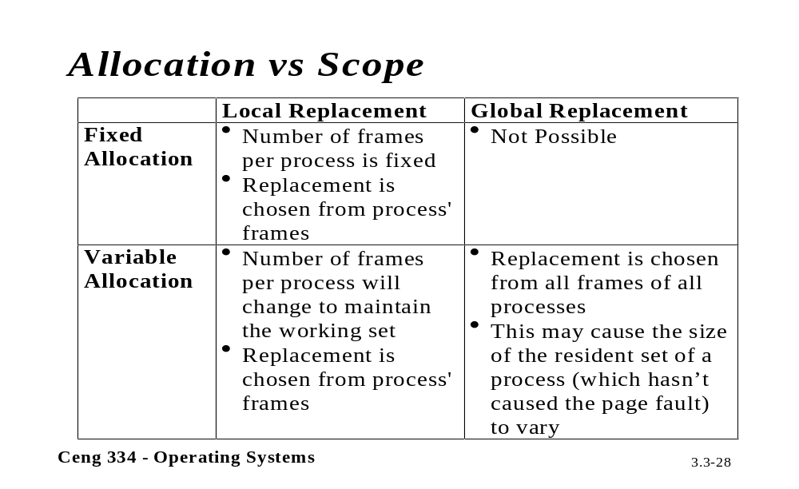
Allocation Vesus Scope

Slide 29
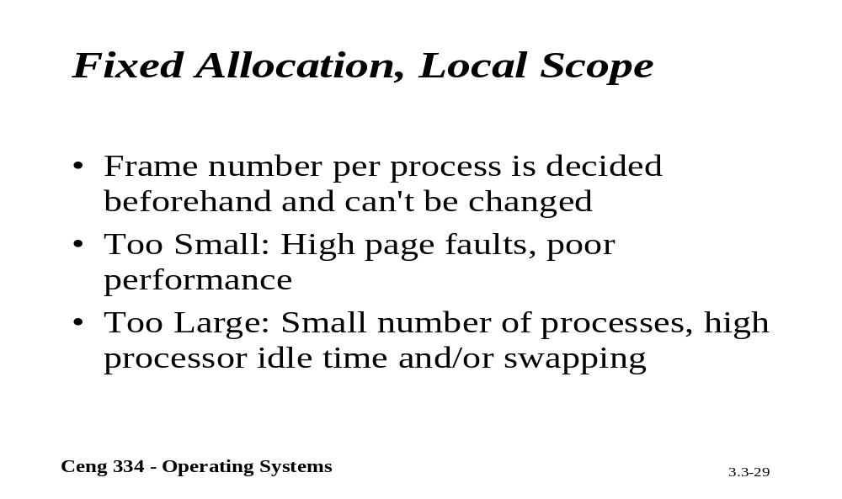
Fixed Allocation, Local Scope

Slide 30
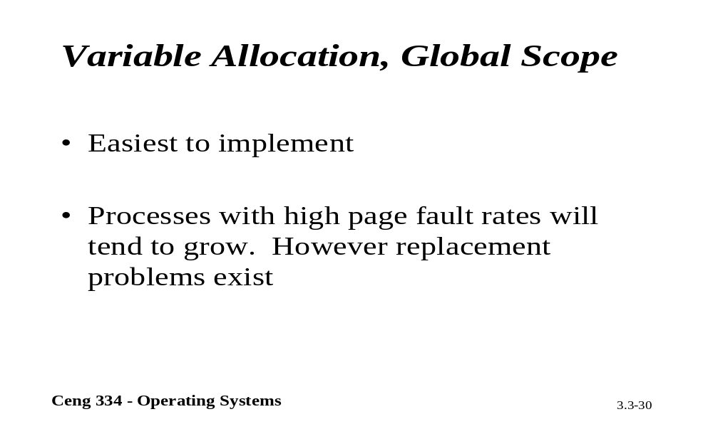
Variable Allocation, Global Scope

Slide 31
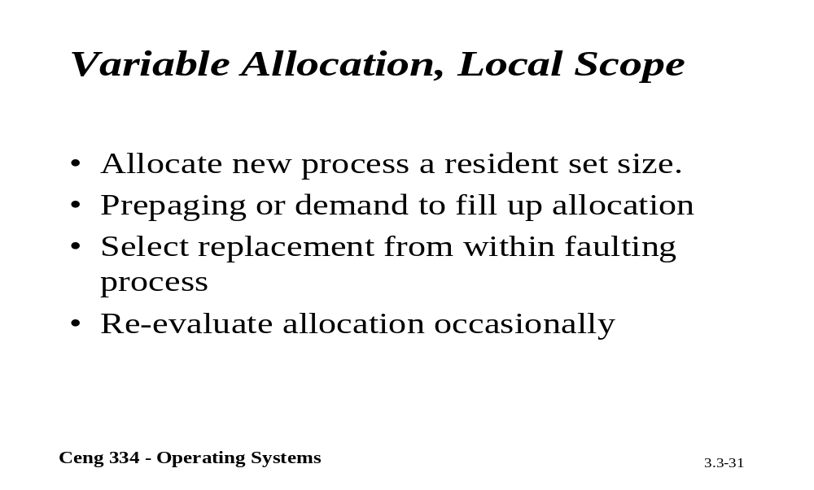
Variable Allocation, Local Scope

Slide 32
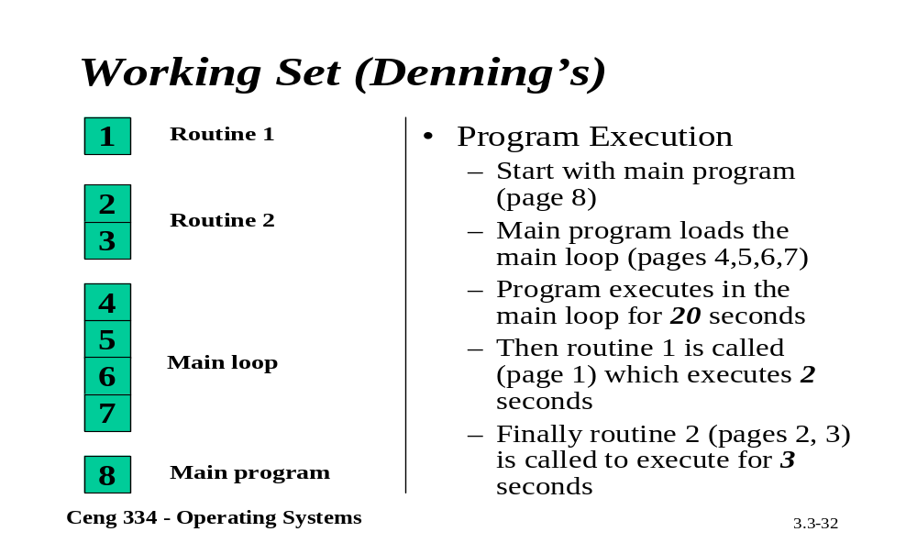
Working Set

Slide 33
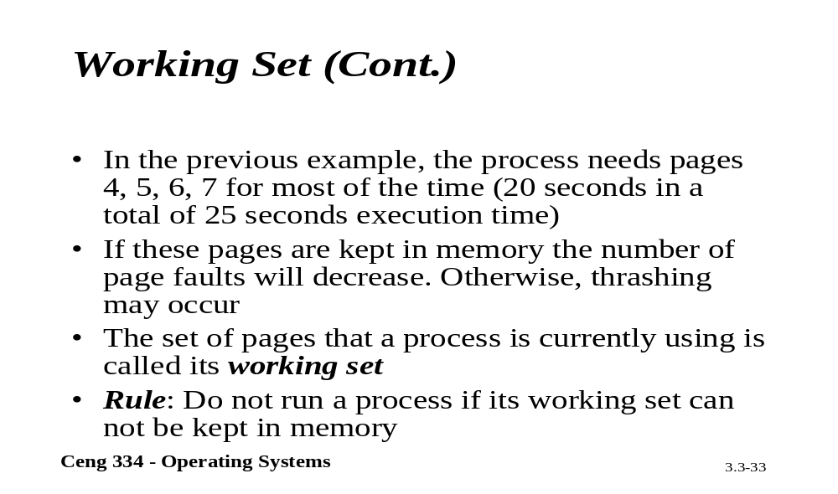
Working Set

Slide 34
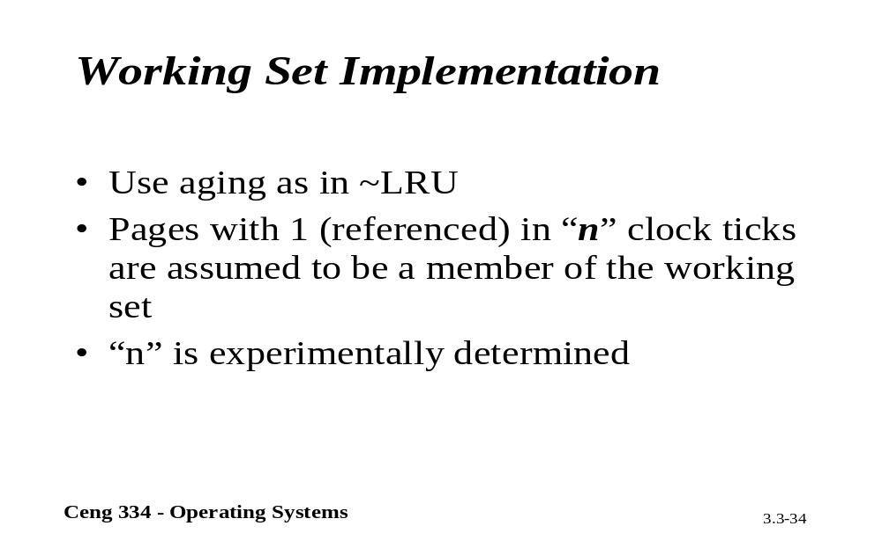
Working Set Implementation

Slide 35
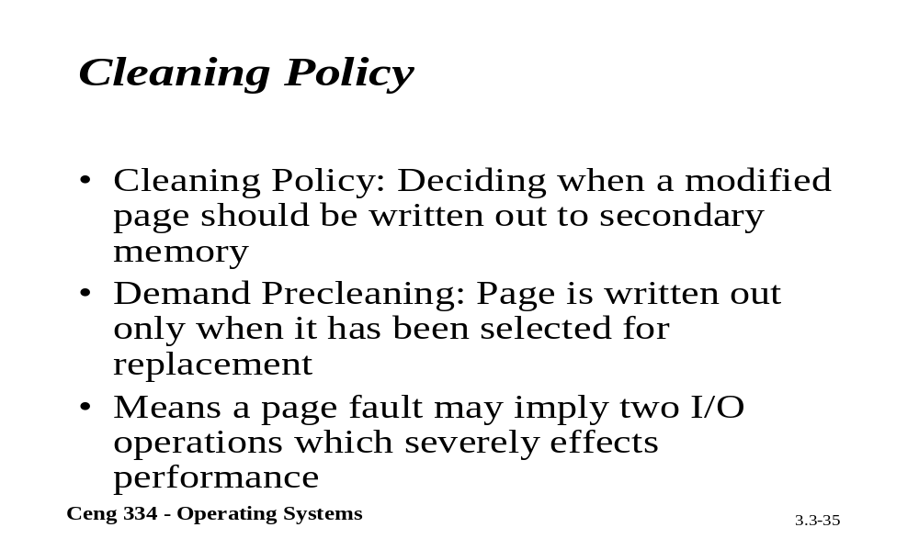
Cleaning Policy

Slide 36
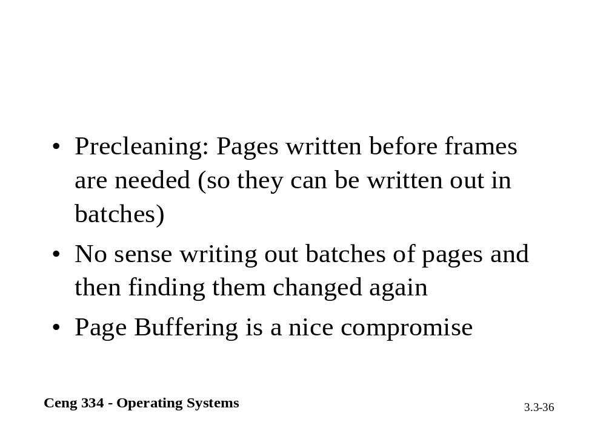

Slide 37
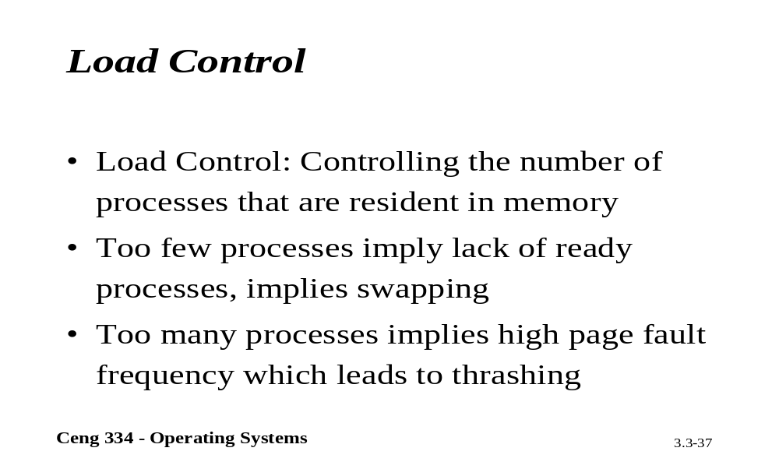
Load Control

